Slide 1
AUTOMATIC MEDICINE Dispenser
PRESENTED BY
ANN MARY PRADEEP
IRENE CYRIAC MERLY
SNEHA SAJU GEORGE
SRUTHY J KURIAN

Slide 2
PROBLEM STATEMENT
Many patients are dependent on others for providing medicines, which leads to more human contact.

Slide 3
EXPLANATION OF PROBLEM STATEMENT
Ever since the coronavirus started a global pandemic, the world has become contact-less.
It is risky for nurses, care-takers to have contact with Covid-19 patients for giving medication every time. Reducing human to human contact is a preventive measure, and also a reason to cause fear among the people.
Other than Covid-19 patients, hospital admitted patients, disabled or sensory impaired patients, patients in rehabilitation centres, aged patients, etc. have difficulty identifying or measuring medicines.
For such patients and their care-takers, a non contact way of providing medicines is needed.

Slide 4
Proposed solution
AUTOMATIC MEDICINE DISPENSER:
The tablets are stored in air tight containers, according to their pattern of consumption
Required tablets will come out into a small cup like holder, according to the time set for medicines, maximum up to 4 times a day
This can be set up using Arduino UNO and an RTC module
Along with this, a simple sound made by a piezo buzzer and an LED light(for deaf and common people) will go on, reminding the person
The person can consume the medicines and replace the cup or bowl to the hollow space under the dispenser

Slide 5
For liquid medicines, the required quantity of medicine will pour out of the reservoir (where the medicine is stored) into small cups
This works using Arduino and an RTC module, with the help of a solenoid valve which creates pressure and pours the medicine
The quantity of medicine is measured using a flowmeter
For different quantity of medicine, there are different ports, so the medicine can be stored accordingly
The person can drink from the cup and replace it under the liquid dispenser
A capacitive sensor at the bottom section where the cups (which is slightly hollow) are placed ensures its position and senses each time when cups are taken and produces a beep sound, letting the user know it is correctly placed

Slide 6
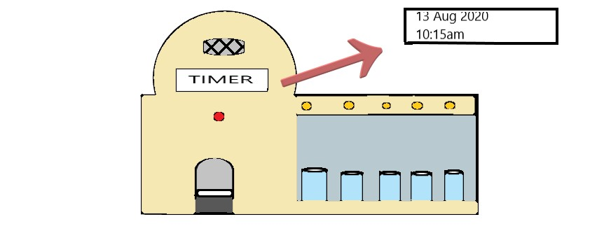
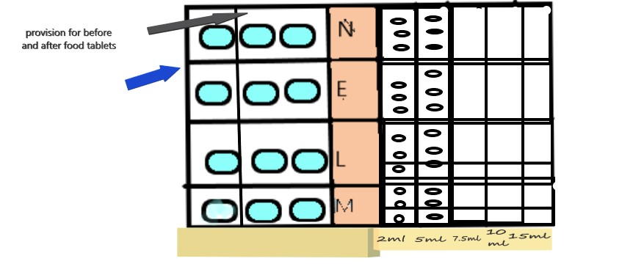
Computerised model of proposed solution
LED light
Cup or
bowl
cups
TOP VIEW
FRONT VIEW

Slide 7
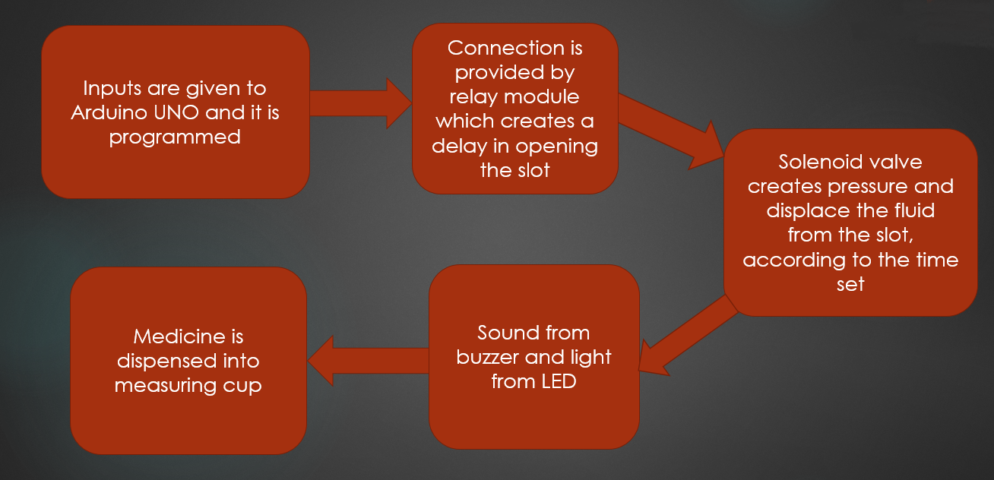
Working of liquid medicine dispenser

Slide 8
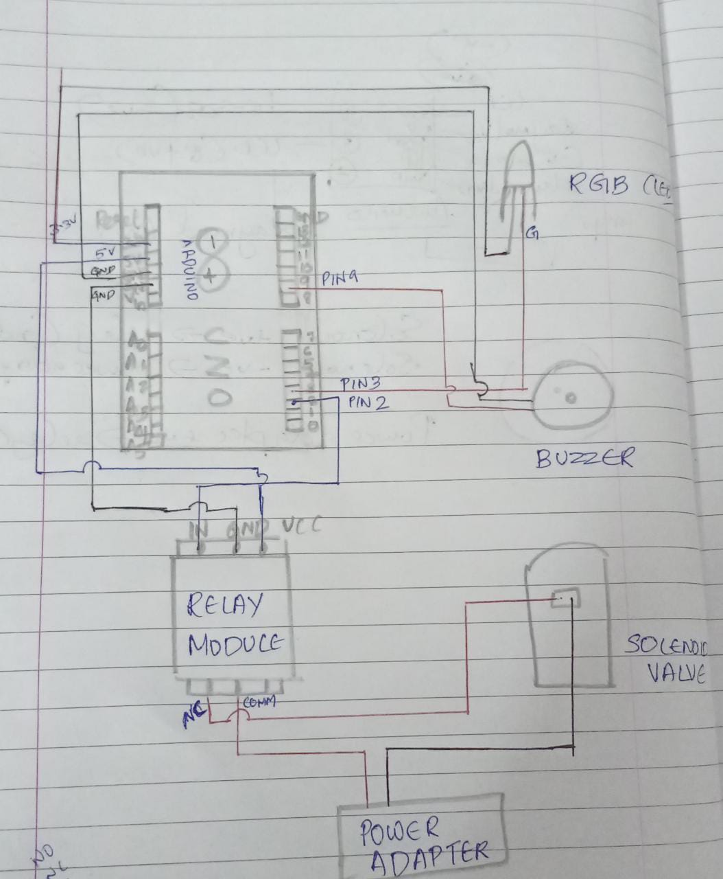
Circuit design

Slide 9
ADVANTAGES
Unlike currently used technology, this medicine dispenser is automatic which ensures contact-less consumption of medicines
Assists with both tablets and liquid syrups
Liquid medicine dispensers are currently not available in the market
It also serves as a reminder for medicines
It saves time and effort
In the long run, this product is extremely feasible

Slide 10
THANK YOU

